Slide 1
ECE 582 Final Project Detect Terre Haute Courthouse
Qiaoyu Dou
Yang Zhang

Slide 2
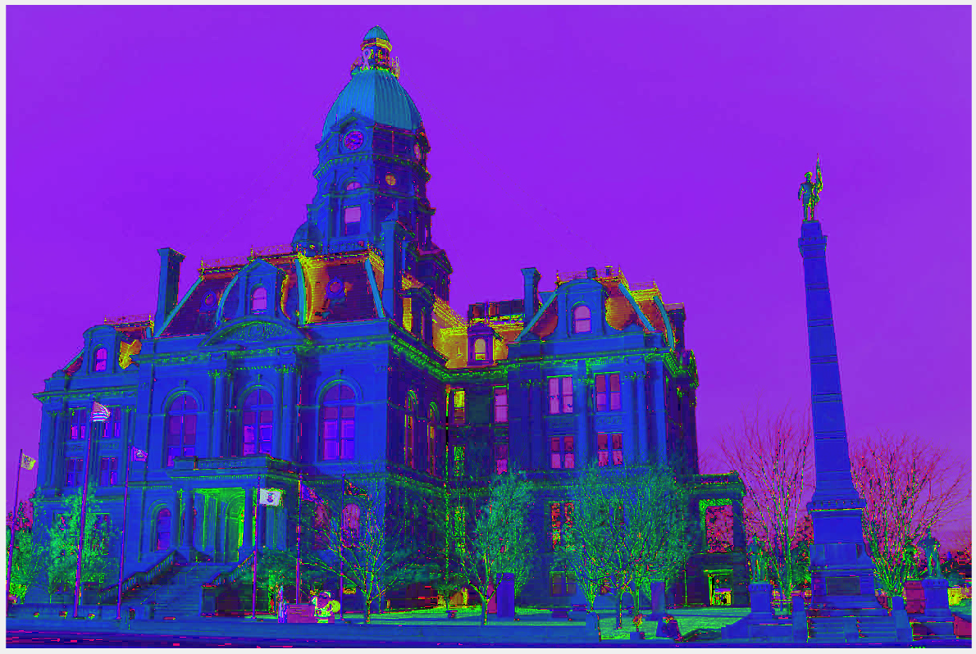
How do we detect the Golden Roof
Turn RGB to HSV
Find the range of Hue and Saturation of the roof
If in the range, set 1, if not, set 0

Slide 3
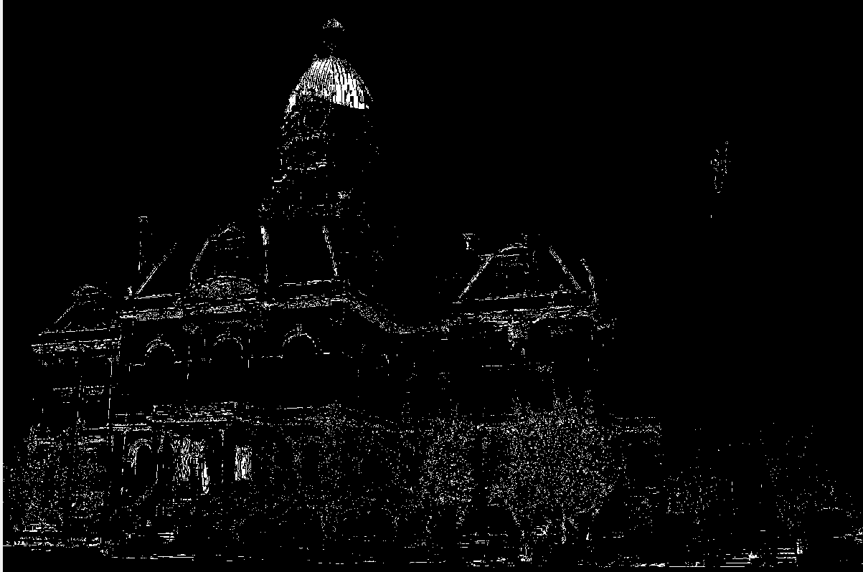
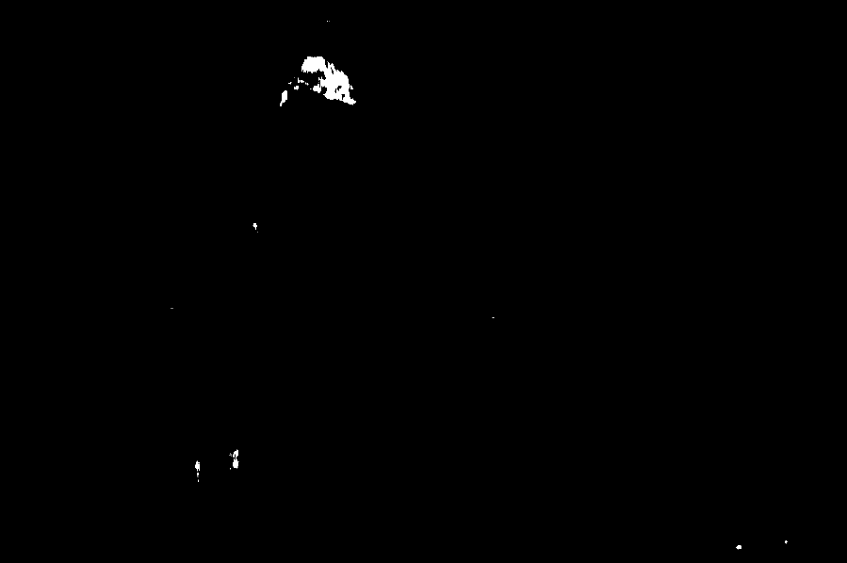
Roof Detected
Use median filter to filter out the white points outside the roof

Slide 4
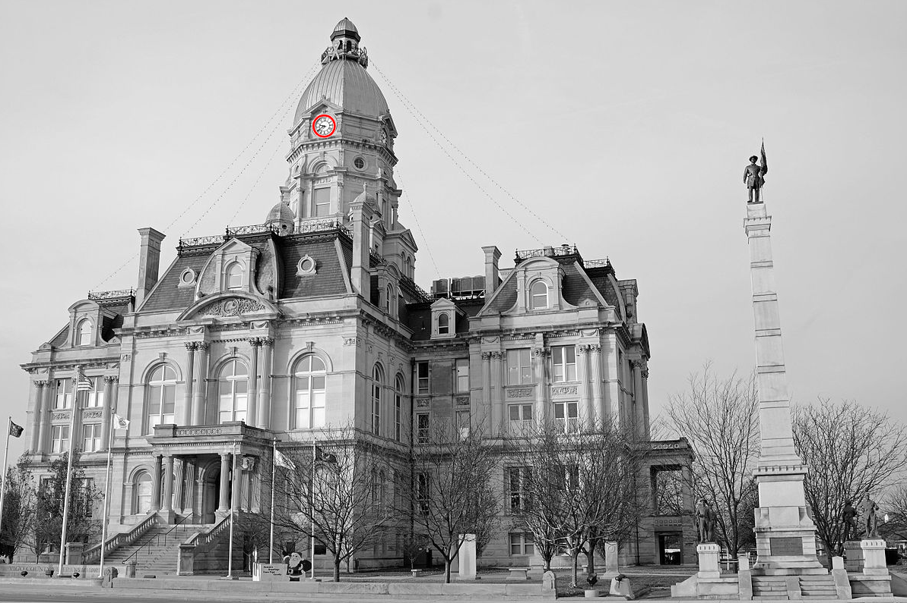
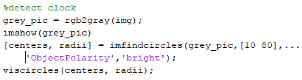
Clock Detect
Using MATLAB built-in function:

Slide 5
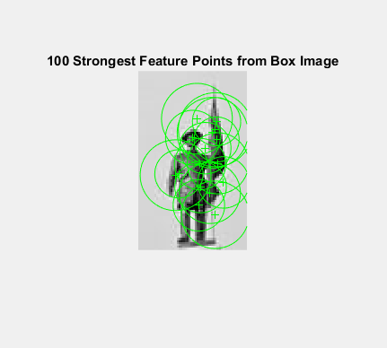
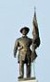
Use Feature Points to Detect the Character
We find 100 strongest feature points in the character picture

Slide 6
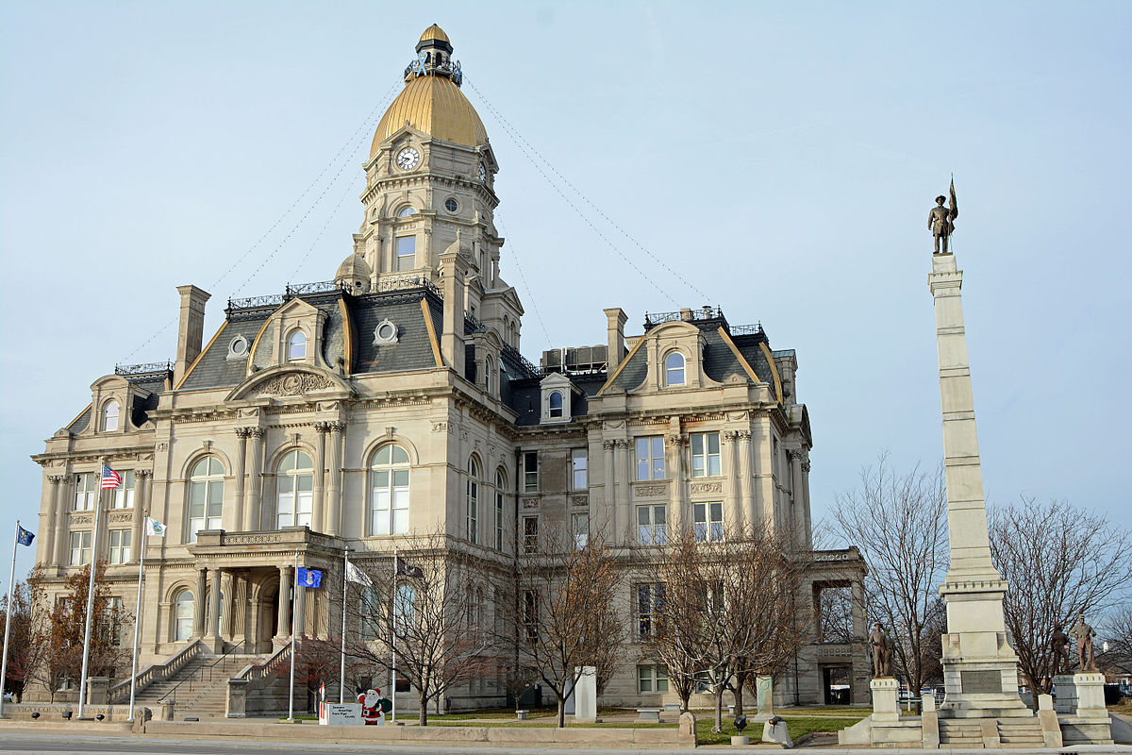
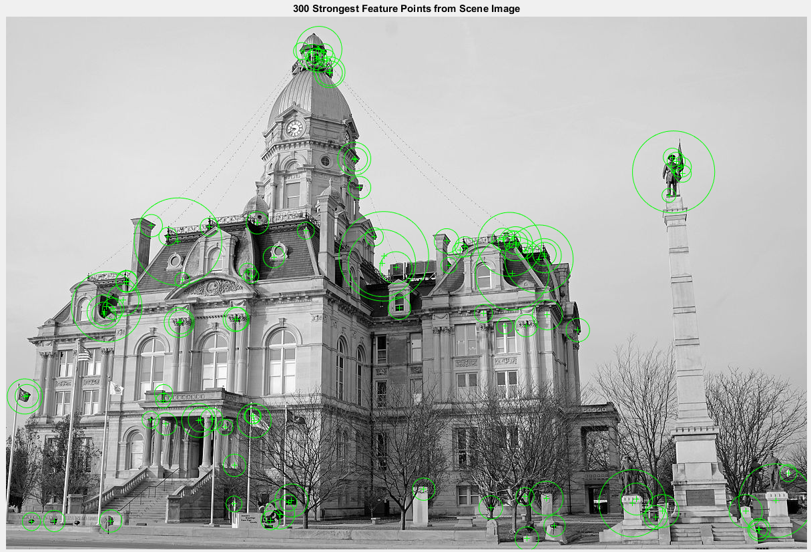
Use Feature Points to Detect Features on the Original Image
Find 300 strongest feature points on the gray-scale picture

Slide 7
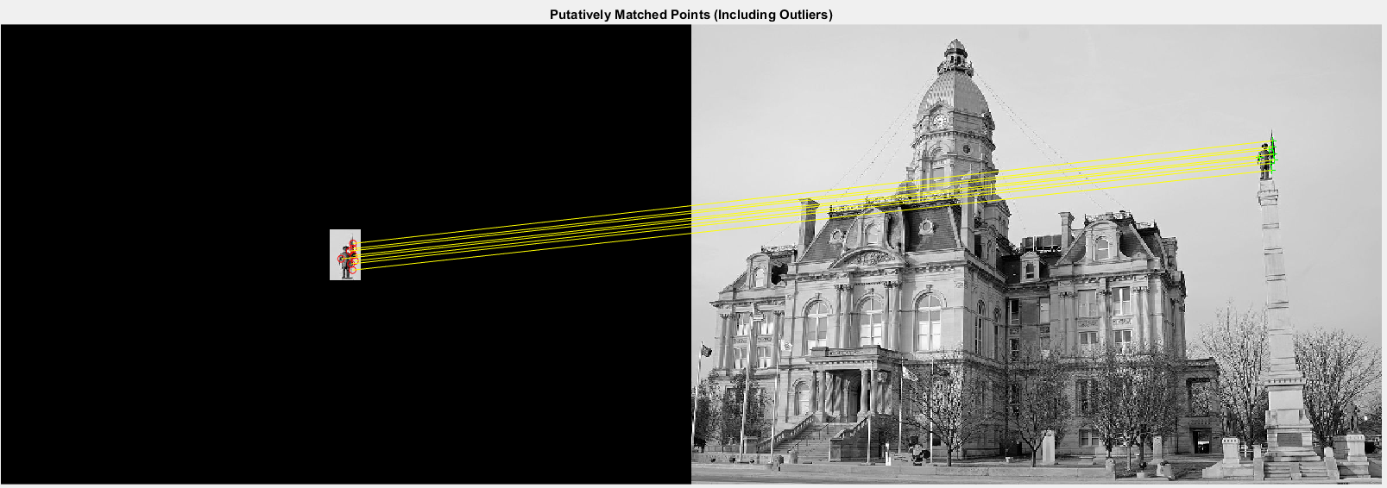
Feature Points Matching
Match the feature points in the character and image

Slide 8
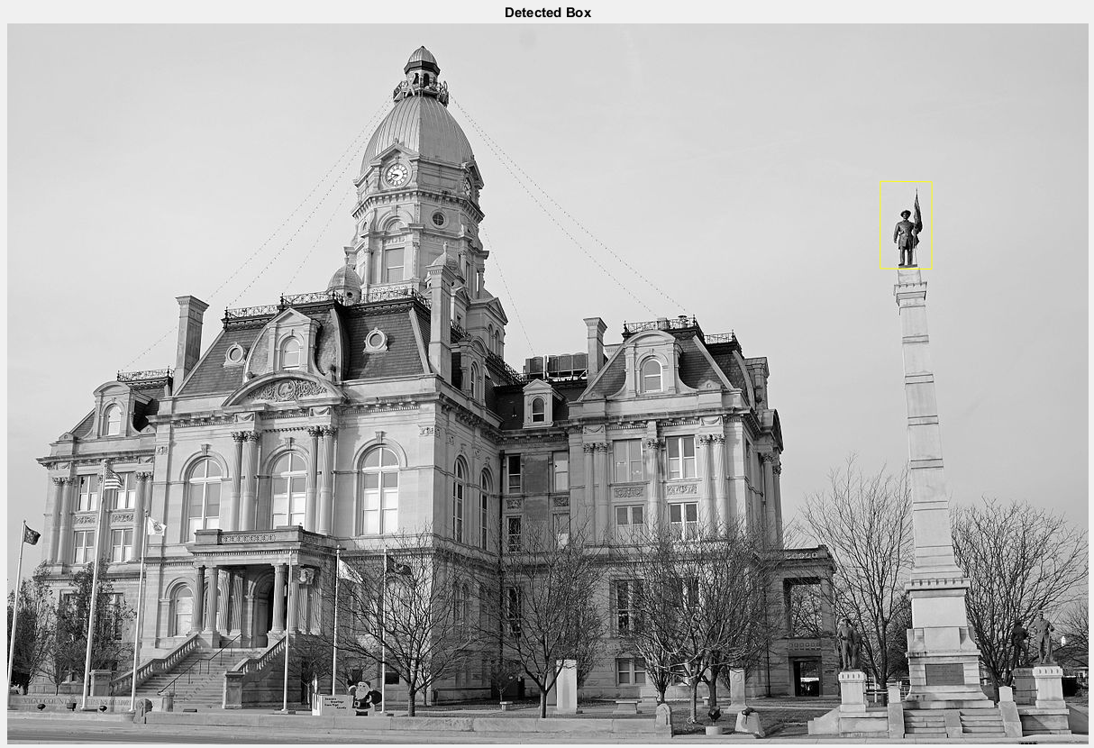
Find the Character

